Slide 1
Overestimating vs underestimating
Task A: Estimating with multiplication and addition
1) Identify if the following gives an overestimate, underestimate or if it is hard to determine.
568.5445 + 453. 56 570 + 500
45.215 × 62.123 50 × 60
5321 × 4236 5000 × 4000
2455 + 2362 × 5466 2500 + 2400 × 5500
0.565 + 0.461 × 0.31 0.6 + 0.5 × 0.2
953 + 56.56 + 0.665 × 0.6 1000 + 60 + 0.5 × 0.5
56.2² + 54.3² 60² + 50²
2) Here is a calculation
8 467 × 13.92 = 117 860.64
a) Write a multiplication that gives a product close to, but a little more than, 117 860.64
b) Write a multiplication that gives a product close to, but a little less than, 117 860.64
Task B: Estimating with division and subtraction
1a) Without calculating,
15.99 ÷ 4
is this a little more than 4, a little less than 4 or exactly 4? .
b) Without calculating,
16 ÷ 3.99
is this a little more than 4, a little less than 4 or exactly 4?

Slide 2
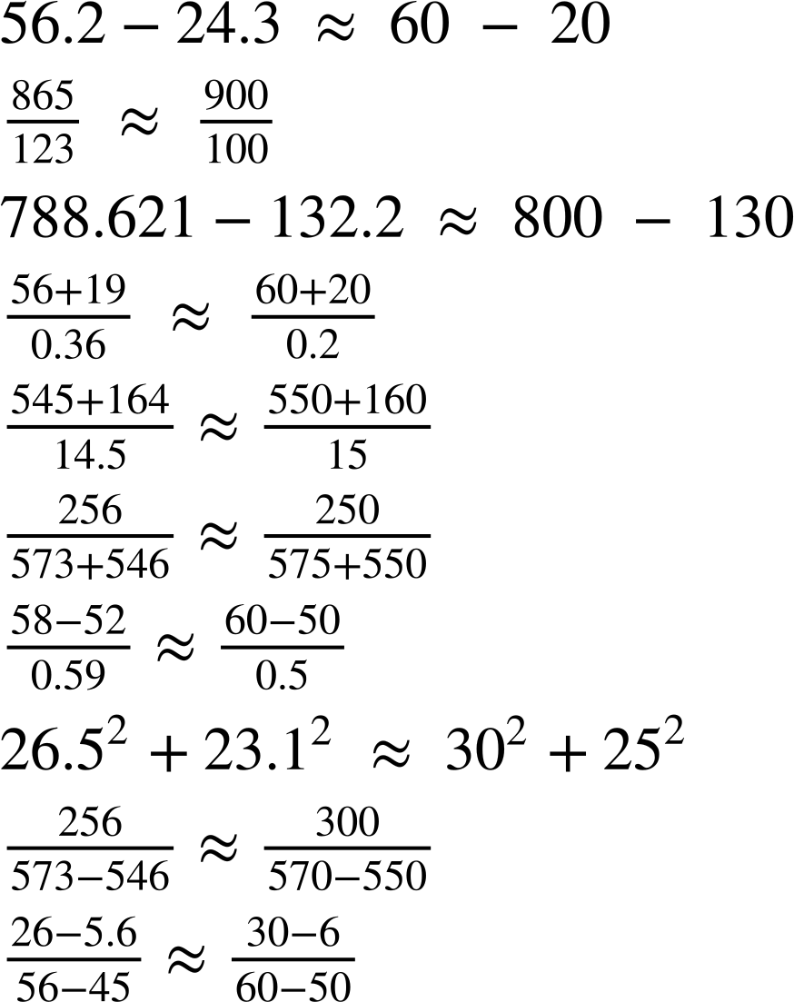
Overestimating vs underestimating
2) Identify if the following gives an overestimate, underestimate or if it is hard to determine.
a)
b)
c)
d)
e)
f)
g)
h)
i)
j)
‹#›

Slide 3
Overestimating vs underestimating
Task C: Overestimating vs underestimating in context
The two signs on the left are from different lifts. Each lift can carry a different number of people.
Lift A
Lift B
🠋 G
▲ 4
Max load
8 persons or 630 kg
Capacity 1000 kg
13 persons
a) Which lift assumes that people are heavier?
b) Which lift is easier to estimate? Why?
c) Nine identical boxes are under the weight limit for one lift, but over it for the other lift. What do you know about the weight of the boxes?
d) Five boxes weighing 23 kg each are put into each lift. Approximately how many people can safely get in the lifts with them?
e) Explain why it is better to overestimate all the scenarios above.
Mathematics in Education and Industry
v2.3

